Slide 1
Capstone Project – The Battle of Neighborhoods
Opening Indonesian Restaurants in Toronto
By: Muhamad Fajrin Rasyid

Slide 2
Introduction
Background
Indonesian food is probably the tastiest invisible food in the world. It has been ranked highly by those who tried it, including recently by CNN, but many still do not know about it. It is not common to see Indonesian restaurant, much less than Thai or Japanese in many big cities around the world outside Indonesia. I suspect the same case is true for Toronto. Therefore, my hypothesis is that, if we develop the business of creating Indonesian restaurant there in the right way, it will become a successful business.
Problem
One of the biggest problems in creating restaurant is finding the right location. Where should we open our Indonesian restaurant? We might want to avoid area where there is already Indonesian restaurant (if any) or to some extent Chinese restaurant as it has slight similarity with Indonesian restaurant.
Interest
Hopefully this will bring benefit to anyone, especially entrepreneurs, who are interested in opening Indonesian restaurant business particularly in Toronto.

Slide 3
Data acquisition and cleaning
Data sources
I am using below data:
List of neighborhoods in Toronto fetched from Wikipedia
Neighborhoods latitude and longitude fetched from geocoder package
Venue data especially related to Indonesian restaurant and Chinese restaurant fetched from Foursquare API

Slide 4
Data acquisition and cleaning
Data cleaning
Before using the data, I need to do some preprocessing regarding the data below:
Delete data where “Borough” column is not identified in the list of neighborhoods data which is fetched from Wikipedia
Of the remaining data in the list of neighborhoods data, set “Neighborhood” column equals to “Borough” column if “Neighborhood” is not assigned
Group neighborhoods having the same postal code
Append the list of neighborhoods data above with its latitude and longitude which is fetched from geocoder package

Slide 5
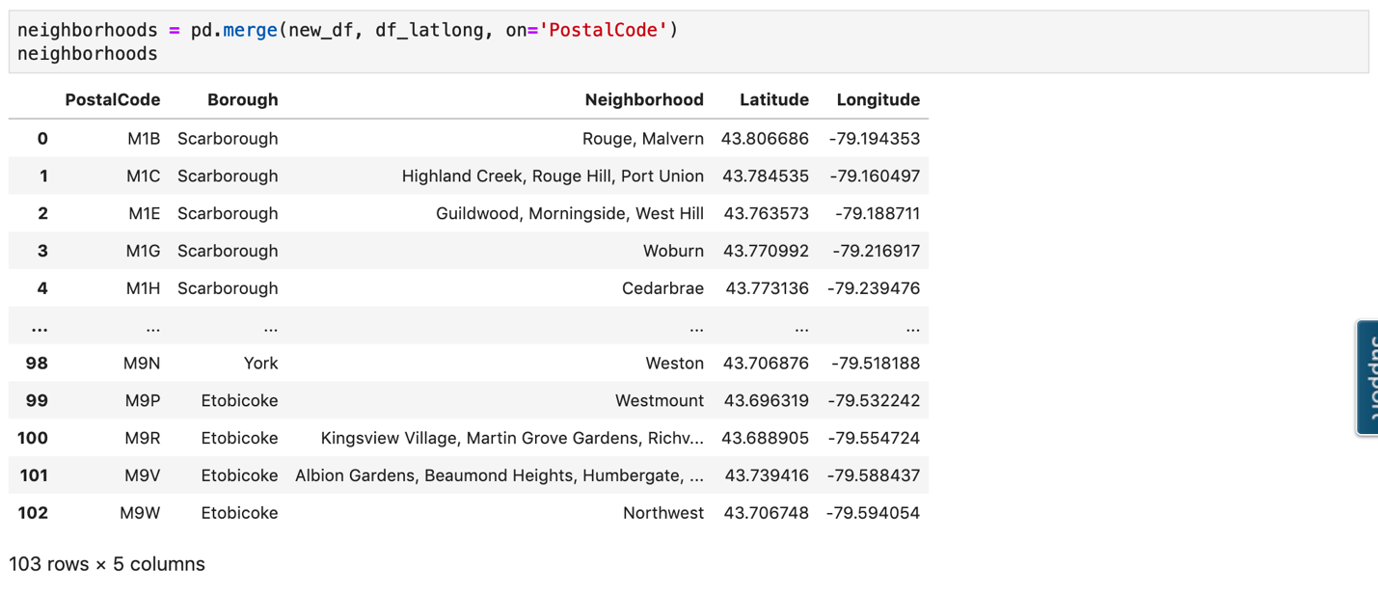
Data acquisition and cleaning
The result of data preprocessing can be seen in the screenshot below.

Slide 6
Methodology
Methodology summary
In solving the problems, I conduct steps below:
Explore venues in each of the neighborhoods using Foursquare API
From venues data, I try to specifically look for “Indonesian restaurant”
I look as well for “Chinese restaurant” as it turns out that there is only one Indonesian restaurant in the whole Toronto
I use K-Means to cluster neighborhoods into three clusters, those with many Indonesian or Chinese restaurants, those with some Indonesian or Chinese restaurants, and those with few or no Indonesian or Chinese Restaurants

Slide 7
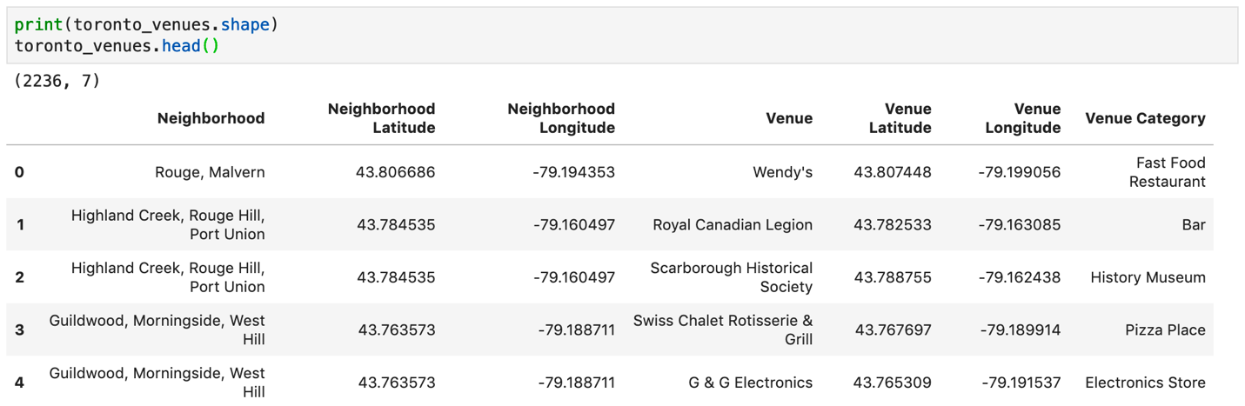
Methodology
Explore venues
I use Foursquare API to explore venues in each of the neighborhoods. I then define the function “getNearbyVenues” that will return all venues in each of the neighborhoods surrounding area in the radius of 500 meters.
I then use the function shape and head to see examples of the venues above. It turns out that there are 2236 venues identified in toronto_venues as seen below.

Slide 8
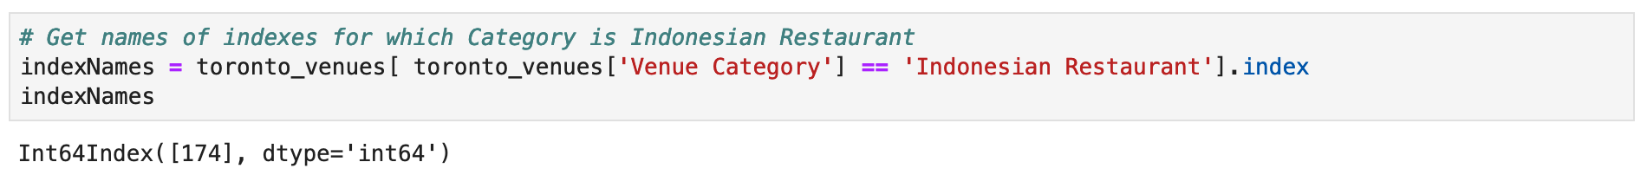
Methodology
Examine Indonesian restaurants
I look for data having “Indonesian restaurant” as venue category as seen below.
Apparently, there is only 1 Indonesian Restaurant in Toronto! That makes it easy - we can just develop Indonesian Restaurant in any neighborhoods except one containing the current Indonesian restaurant. However, let us broaden the search to also include Chinese Restaurant as although not that similar, Indonesian food has slight similarity with Chinese food.

Slide 9
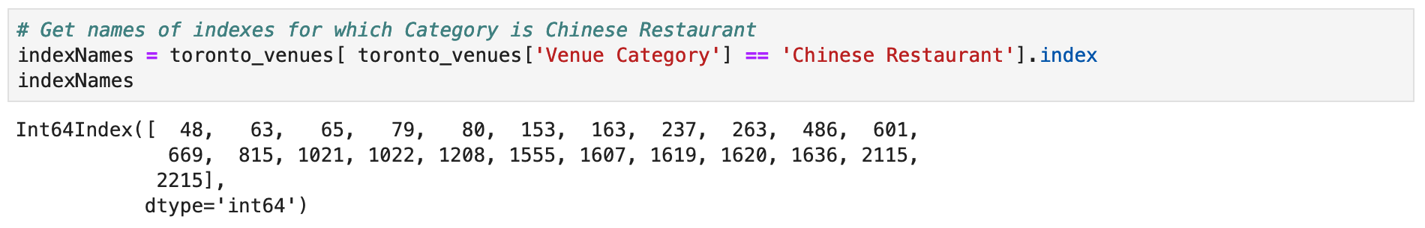
Methodology
Examine Chinese restaurants
I look for data having “Chinese restaurant” as venue category as seen below.
It seems more promising – there are 23 Chinese restaurants in Toronto. We can then find which neighborhoods contain many Indonesian or Chinese restaurants, which contain some, and which contain few or none.

Slide 10
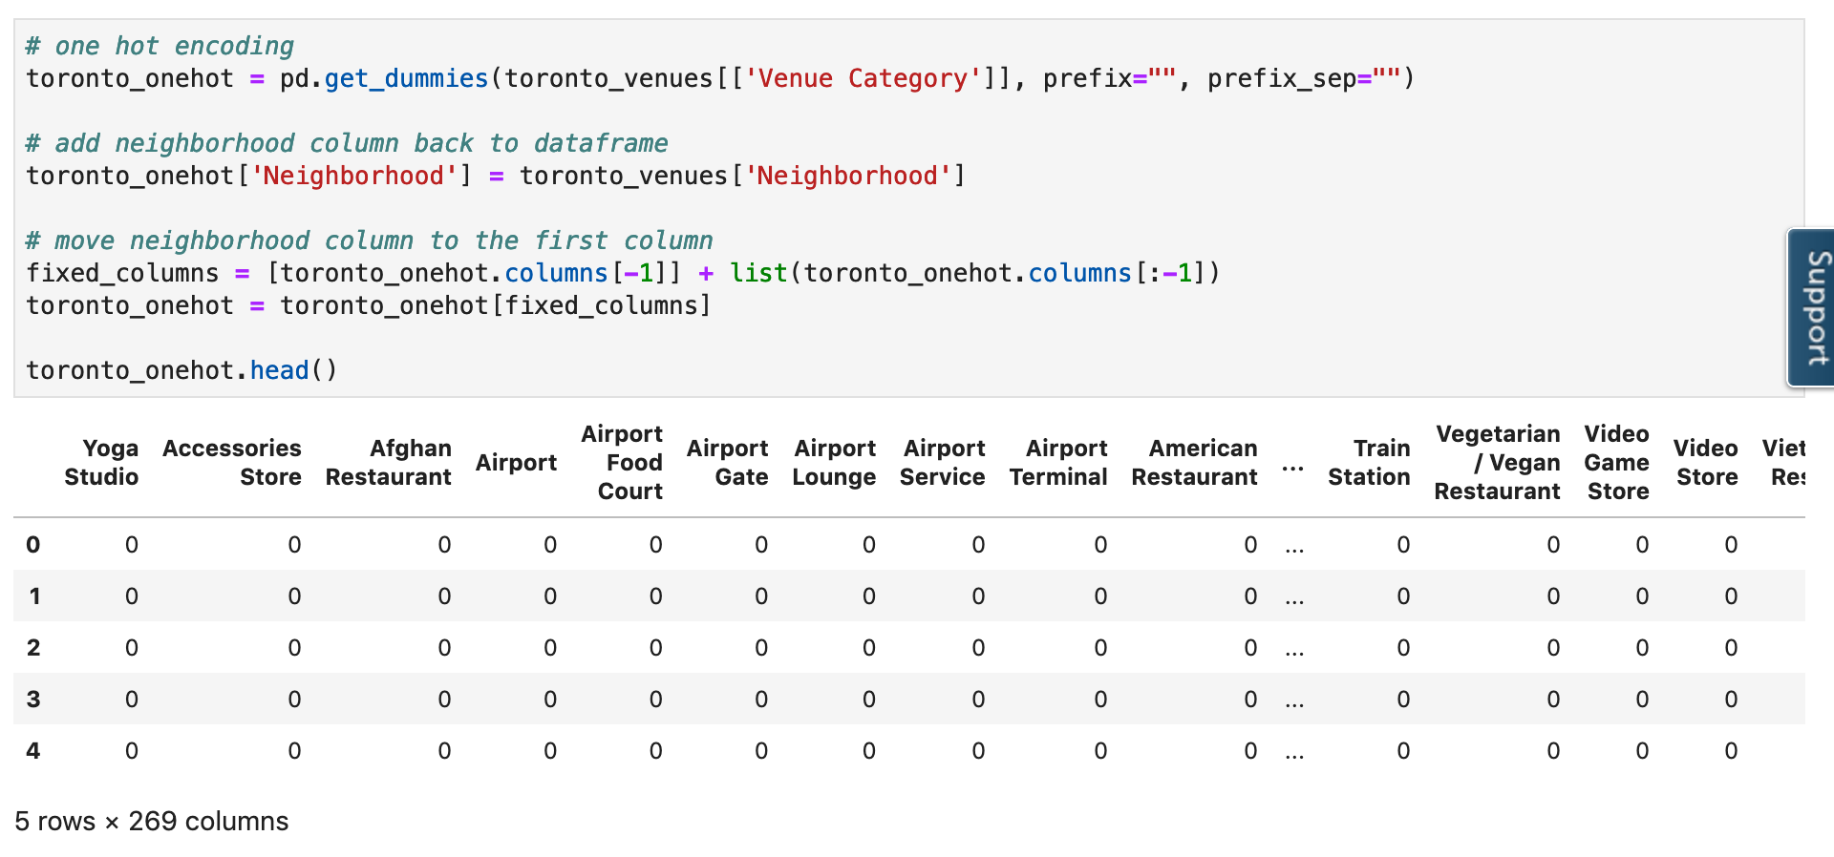
Methodology
Use K-Means to cluster neighborhoods into three clusters (part 1)
Finally, I use K-Means to cluster neighborhoods into three clusters:
Cluster with neighborhoods which contain few or no Indonesian or Chinese restaurants
Cluster with neighborhoods which contain some Indonesian or Chinese restaurants
Cluster with neighborhoods which contain many Indonesian or Chinese restaurants
I first reshape the data to include each of the venues category as column as shown below.

Slide 11
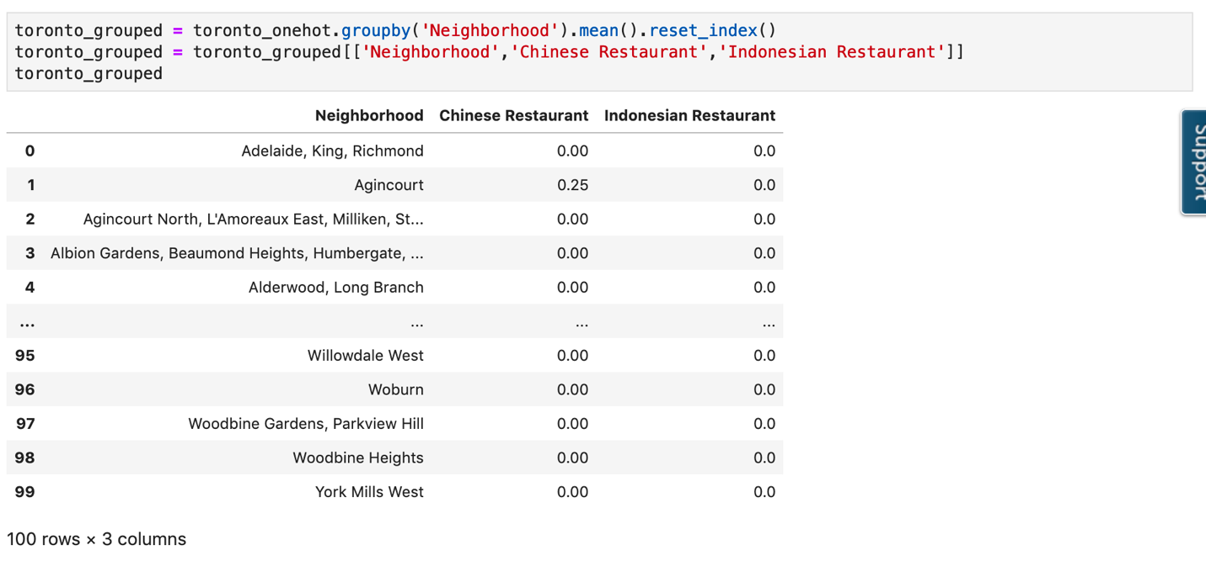
Methodology
Use K-Means to cluster neighborhoods into three clusters (part 2)
I then group rows by neighborhood and by taking the mean of the frequency of occurrence of each category and specifically choose "Indonesian Restaurant" and "Chinese Restaurant" columns. I group this into “toronto_grouped” variable.

Slide 12
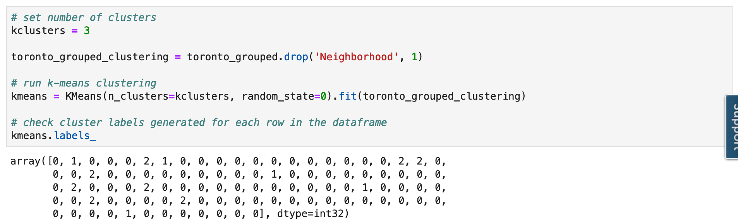
Methodology
Use K-Means to cluster neighborhoods into three clusters (part 3)
I then ready to cluster the neighborhoods using K-Means on toronto_grouped as shown below.

Slide 13
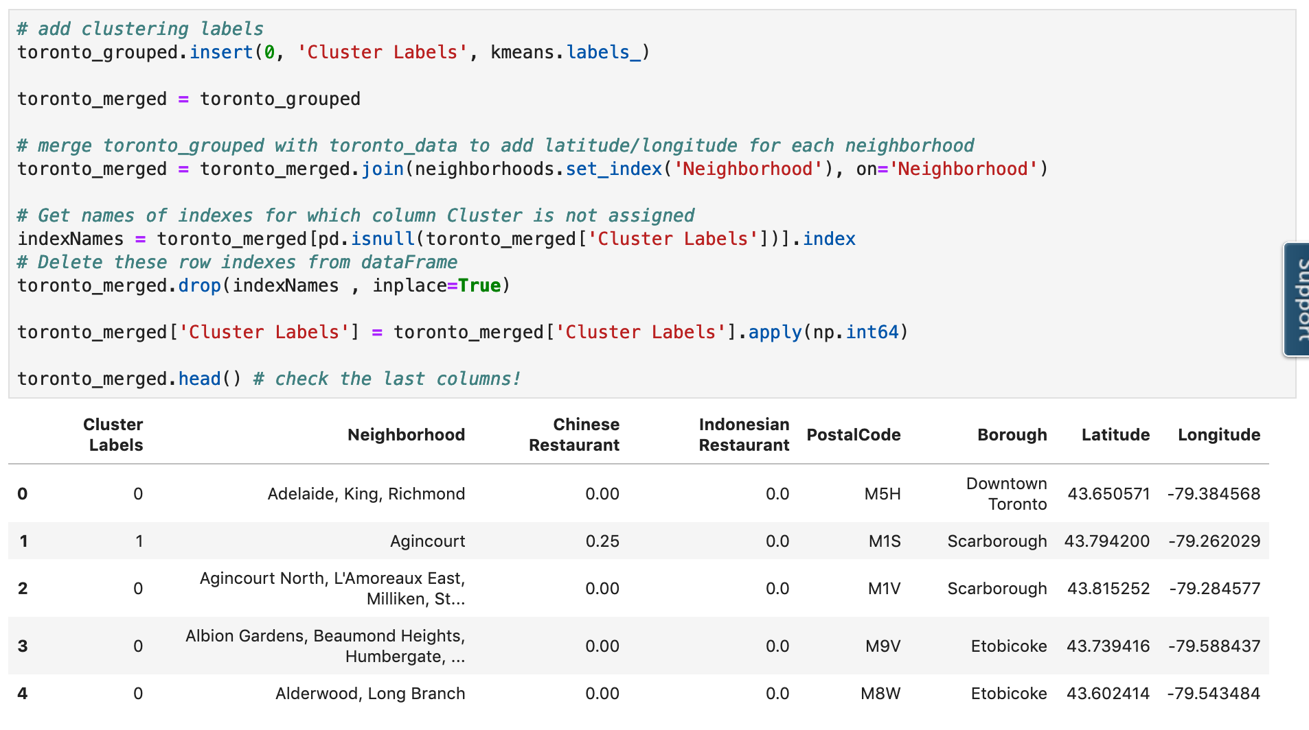
Result
Result (part 1)
I have clustered neighborhoods into three clusters (cluster 0 with no or few Indonesian or Chinese restaurants, 1 with many, and 2 with some). I then merge toronto_grouped with original neighborhoods data to get latitude and longitude of each neighborhoods as seen below.

Slide 14
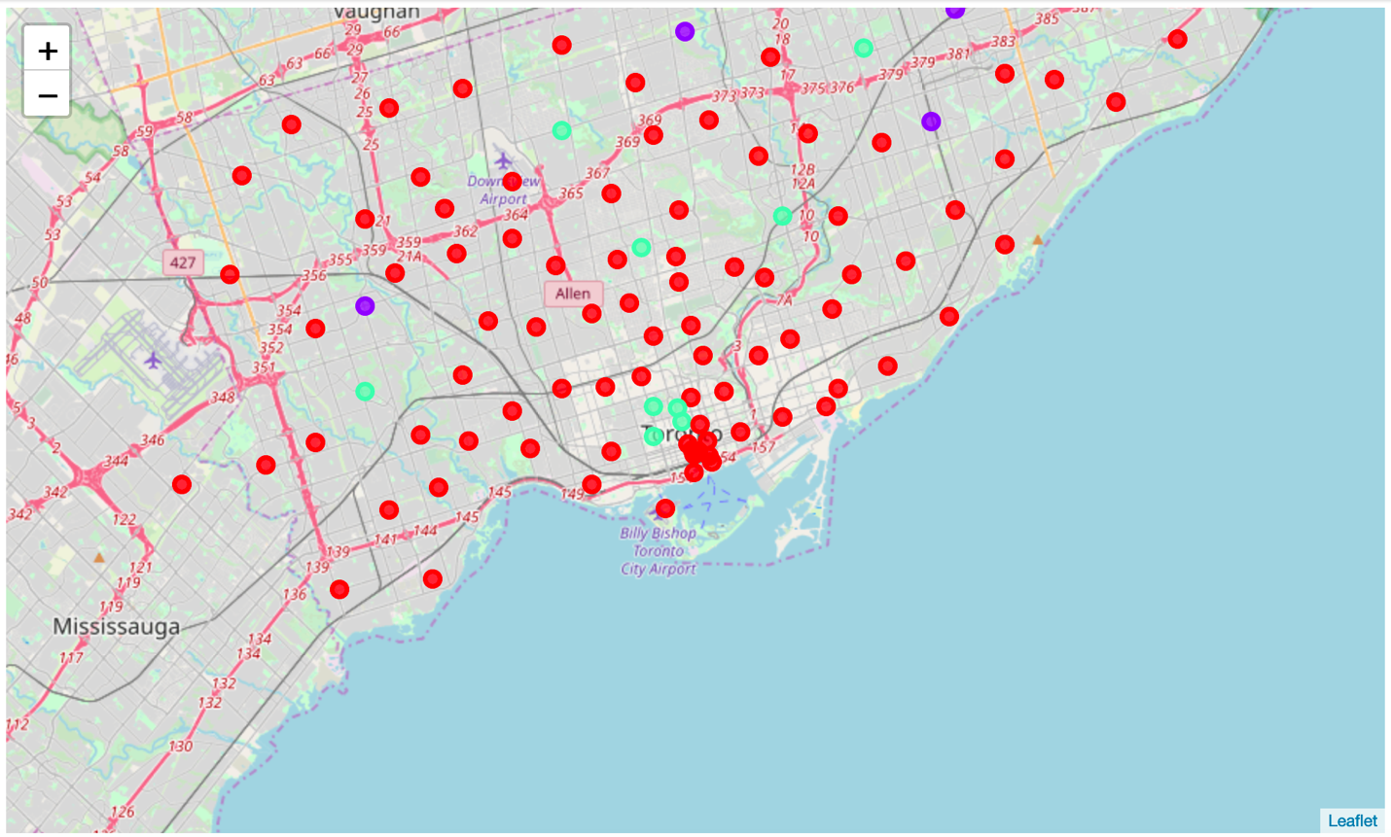
Result
Result (part 2)
The merged data is enough for us to visualize the cluster in the map. I generate the map and below is the result. Note that red circle represents Cluster 0, purple represents Cluster 1, and green circle represents Cluster 2.
We can now see which neighborhoods belong to which cluster.

Slide 15
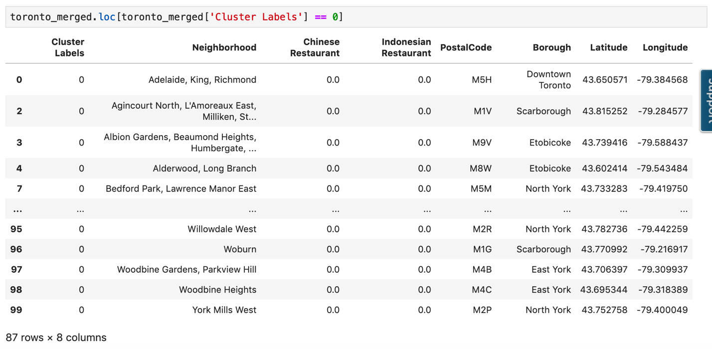
Result
Cluster 0 - where there is no or few Indonesian or Chinese restaurants

Slide 16
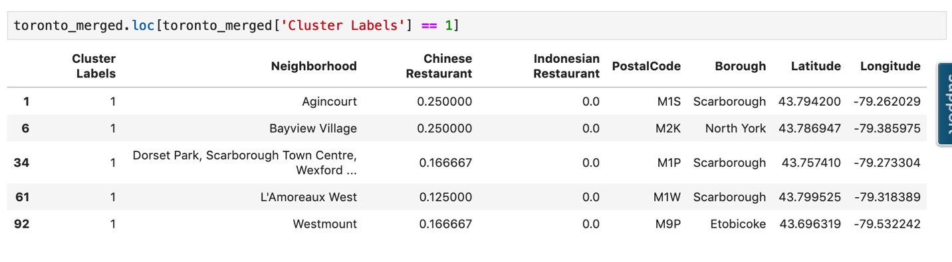
Result
Cluster 1 - where there are many Indonesian or Chinese restaurants

Slide 17
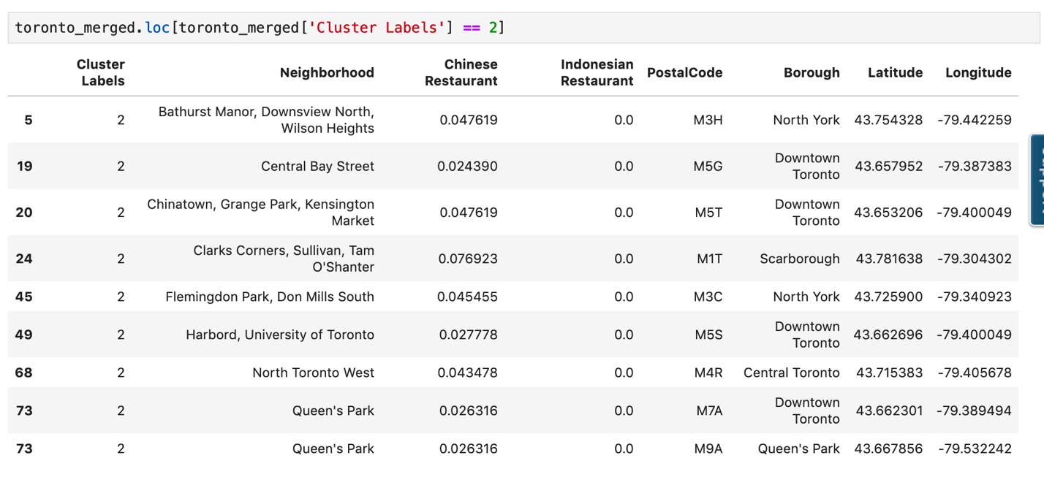
Result
Cluster 2 - where there are some Indonesian or Chinese restaurants

Slide 18
Conclusion
Out of around 100 neighborhoods, only 5 neighborhoods have many Indonesian or Chinese restaurants, specifically those belong in Cluster 1, for example, Agincourt. More than 80% of the neighborhoods contain no or very few Indonesian or Chinese restaurants, specifically those belong in Cluster 0. Therefore, I recommend those who want to open Indonesian restaurant to start by looking areas in neighborhoods in Cluster 0.

